Slide 1
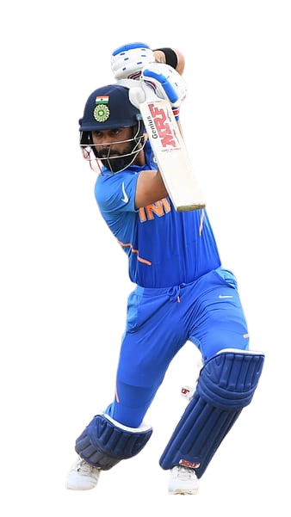
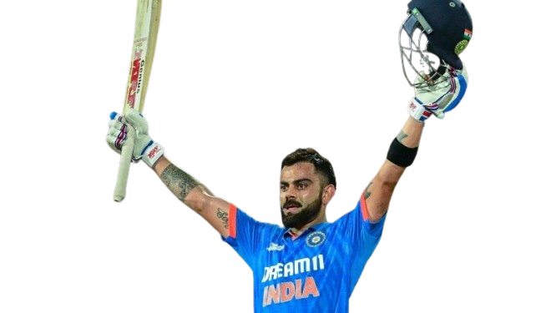
Virat Kohli ODI Match Stats
Rohit Ingole

Slide 2
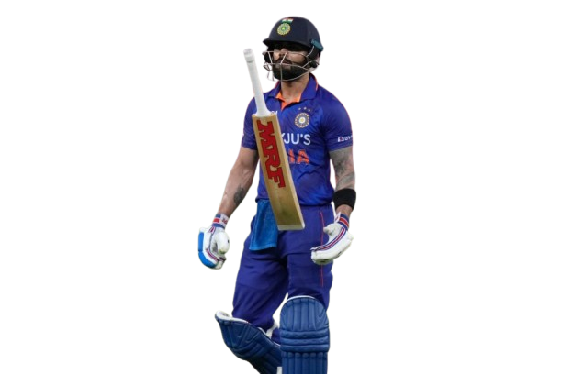
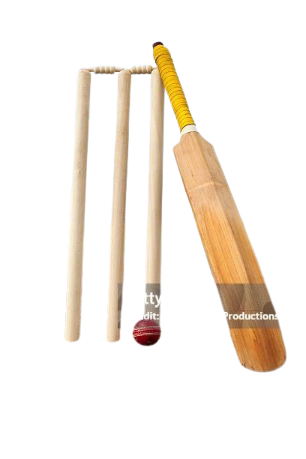
Dismissal in ODI Match
Caught in the dominant dismissal method: A significant majority of dismissals (approximately 80) were due to catches.
Bowled and LBW follow at a distance: These two methods account for a noticeable number of dismissals, with "bowled" being slightly higher.
Run out and stumped are less frequent: These methods resulted in a moderate number of dismissals, with "run out" being slightly more common.
Hit wicket and not out are rare: These methods were responsible for minimal dismissals.

Slide 3
No of Opposition Team Face in ODI Match
Sri Lanka and England have faced the most opposition teams: Both teams have competed against around 20-25 teams, indicating a high level of international participation.
Australia and West Indies have faced a significant number of teams: These teams have faced around 18-20 teams, suggesting a strong international presence.
Bangladesh and South Africa have faced a moderate number of teams: These teams have competed against around 14-16 teams, indicating a good level of international exposure.
Zimbabwe, New Zealand, and Pakistan have faced a lower number of teams: These teams have faced around 10-14 teams, suggesting a less extensive international schedule.
Ireland and Netherlands have faced the fewest teams: These teams have competed against around 4-6 teams, indicating a limited international experience.

Slide 4
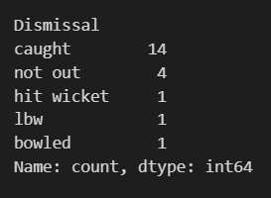
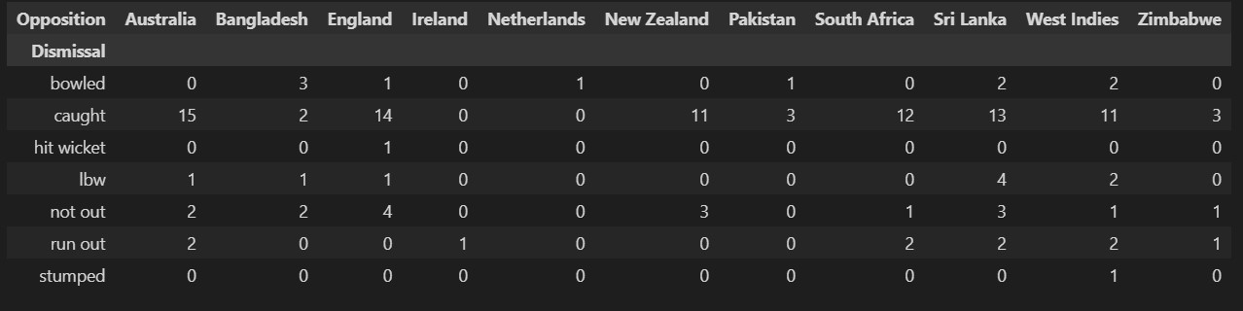
How are different teams getting dismissed, and what are the most common types of dismissals for each team?
Caught is the predominant dismissal method: It's the most frequent dismissal type for most teams.
Bowled and LBW are less common: These methods account for a smaller proportion of dismissals compared to caught.
Hit wicket is a rare occurrence: Only a few instances of hit wicket dismissals are observed.
Not out and run out are relatively infrequent: These methods contribute to a smaller percentage of dismissals.
Stumped is the least common dismissal method: It's the least frequent dismissal type among all teams.

Slide 5
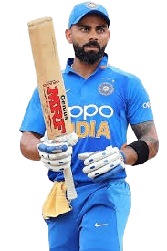
FIRST innings or SECOND innings play effectively?
The 2nd Innings contributes significantly more to the total runs scored.
57.58% of the total runs were scored in the 2nd Innings.
42.42% of the total runs were scored in the 1st Innings.

Slide 6
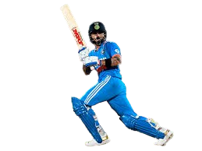
Which Position are ideal for playing cricket
Position 3 is the highest-scoring batting position: This position has accumulated significantly more runs compared to other positions.
Positions 1, 2, 5, 6, and 7 have contributed minimal runs: These positions have recorded very low run totals, suggesting limited opportunities or lower scoring abilities in those spots.
Position 4 has a moderate run contribution: While not as dominant as position 3, it has scored a noticeable amount of runs.

Slide 7
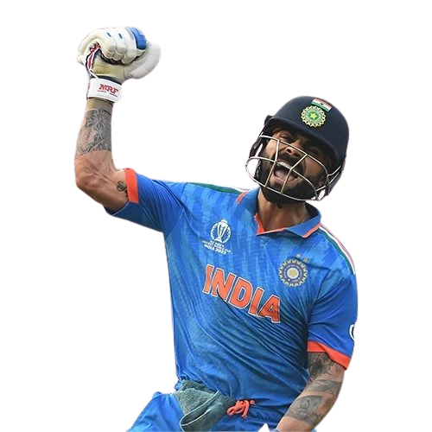
Monthly Run Statistics
Significant Variation in Runs by Month: The graph illustrates substantial differences in the number of runs scored across different months.
Highest Runs in Month 10: Month 10 stands out with the maximum runs scored, reaching approximately 1500 runs.
Lowest Runs in Month 4: Month 4 records the lowest number of runs, with the value close to zero.
Consistent Run Scoring in Months 1, 2, 11, and 12: These months show a relatively consistent run-scoring pattern, with totals ranging from 1400 to 600 runs.
Moderate Runs in Months 6 and 7: Months 6 and 7 exhibit moderate run scoring, with values around 400 runs.

Slide 8
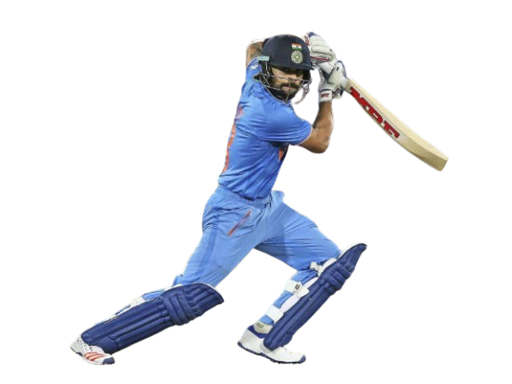
Balls and Runs correlation
There seems to be a positive correlation between Ball Face and Runs. This suggests that as the Ball Face value increases, the number of Runs tends to increase as well.
Early data points show less consistent correlation.

Slide 9
Against which team do batsmen hit more fours and sixes
Australia and West Indies emerge as the teams against which batsmen tend to hit more fours and sixes. This could be due to various factors, such as the nature of their bowling attacks, the conditions of their pitches, or the batting strategies adopted by visiting teams.
Fours count is more that’s why batsmen play safe game. don’t play more risky shorts.

Slide 10
top 10 highest run totals are based on the performance at various stadiums
Dhaka emerges as the stadium with the highest total runs, followed by Chennai and Colombo (RPS).
There is a significant gap between the top 3 stadiums and the rest, indicating that some stadiums are consistently more conducive to high-scoring matches.
In that case, more stadiums are home stadiums.
But in Colombo and Dhaka stadium vary good performance

Slide 11
Conclusion
Spinners: Batsmen are not comfortable playing spinners slowly, especially with the front foot.
Summer: Batsmen play slower and score fewer runs in the summer session due to fewer matches.
Winter: Batsmen play faster and have better averages in the winter session, which is their peak time.
The 2nd Innings contributes significantly more to the total runs scored. That’s why team wining percentage more.

Slide 12
References
https://www.google.com/search?q=virat+kohli+Drive+png+photos&rlz=1C1ONGR_enIN1018IN1018&oq=vi&gs_lcrp=EgZjaHJvbWUqBggBEEUYOzIGCAAQRRg7MgYIARBFGDsyBggCEEUYOzIGCAMQRRg5MgcIBBAAGIAEMgYIBRBFGD0yBggGEEUYPDIGCAcQRRg80gEINTM0MmowajeoAgCwAgA&sourceid=chrome&ie=UTF-8
https://www.remove.bg/
https://chat.openai
https://gemini.google.com/app
https://www.kaggle.com/datasets/shadabhussain/virat-kohli-odi-dataset

Slide 13
Thank you

